Slide 1
Chapter 7
Information Processing
Notes:
Discussion: Earliest memory

Slide 2
Conceptualizing Memory and Learning (1 of 4)
Information-processing approach to cognition:
  Emphasizes the basic mental processes involved in attention, perception, memory, and decision making
  Computer Analogy: “Mental Hardware” vs “Mental Software”

Slide 3
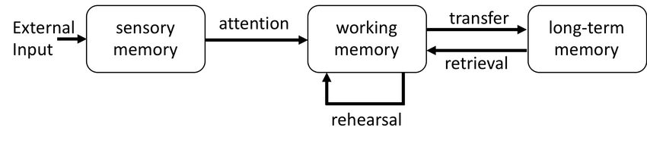
Conceptualizing Memory and Learning (2 of 4)
Information-processing framework (Atkinson & Shiffrin, 1968):
  Sensory register
  Short-term/Working memory
  Long-term memory

Slide 4
Conceptualizing Memory and Learning (3 of 4)
Memory:
  Our ability to store and later retrieve information about past events
  Develops and changes over the life span
Learning:
  The acquisition of knowledge and skills from experience

Slide 5
Conceptualizing Memory and Learning (4 of 4)
Based on this approach:
  Cognitive development results from the maturing nervous system plus environmental experiences
  Result is that adults have better memory than young children.

Slide 6
Information Processing Theory (1 of 3)
Like a computer, the information processing asserts that the human mind is designed to manipulate information
Information Processing Assumes:
  Thinking is information processing
  Cognitive change is a continuous process
  Our cognitive resources are limited
Notes:
Learning Objective: 7-1: Discuss information processing theory, including its assumptions and three mental stores.
I. Information Processing Theory
A. Like a computer, the information processing asserts that the human mind is designed to manipulate information
B. Information Processing Assumptions
a. Thinking is information processing
b. Cognitive change is a continuous process
c. Our cognitive resources are limited

Slide 7
Information Processing Theory (2 of 3)
Encode:
  Get information into the system.
Consolidation:
  Information is processed and organized in a form suitable for long-term storage.
Storage:
  Refers to holding information in a long-term memory store

Slide 8
Information Processing Theory (3 of 3)
Retrieval:
  Process of getting information out when it is needed
Two types:
  Recognition memory: Recognition among the options
  Recall memory: Requires active retrieval without the aid of cues

Slide 9
Mental Storage (1 of 3)
Sensory memory: first step in getting information into the mind
  incoming sensory information is held in its original form to determine whether it must be processed or considered
    Lasts for a fraction of a second
    Mostly outside of conscious awareness
Attention: focus of mental resources that allows sensory memory to pass to working memory
  Can’t encode information that isn’t attended to!
Notes:
Learning Objective: 7-1: Discuss information processing theory, including its assumptions and three mental stores.
a. Sensory memory: the first step in getting information into the mind
where incoming sensory information is held in its original form to determine whether it must be processed or considered
b. Attention: focus of mental resources that allows sensory memory to pass
to working memory
c. Working memory: holds and processes information that is being
“worked on” in some way
i. Short-term store
ii. Processing component
iii. Control center that directs memory processes
d. Working memory is responsible for manipulating, encoding, and
retrieving information

Slide 10
Mental Storage (2 of 3)
Working memory: holds and processes information that is being “worked on” in some way
Rule of thumb: 7 ± 2
Short-term
  Responsible for manipulating, encoding, and retrieving information
  Passes information to long-term memory
Notes:
Learning Objective: 7-1: Discuss information processing theory, including its assumptions and three mental stores.
a. Sensory memory: the first step in getting information into the mind
where incoming sensory information is held in its original form to determine whether it must be processed or considered
b. Attention: focus of mental resources that allows sensory memory to pass
to working memory
c. Working memory: holds and processes information that is being
“worked on” in some way
i. Short-term store
ii. Processing component
iii. Control center that directs memory processes
d. Working memory is responsible for manipulating, encoding, and
retrieving information

Slide 11
Mental Storage (3 of 4)
Central executive: control mechanism in working memory that directs the flow of information and regulates cognitive activities
  Executive function: cognitive activities of the central executive
Both are strongly related to attentional capabilities!
Notes:
Learning Objective: 7-1: Discuss information processing theory, including its assumptions and three mental stores.
e. Central executive: an important control mechanism in working memory
that directs the flow of information and regulates cognitive activities such as attention, action, and problem solving, determining what is important to attend to
f. Executive function: the cognitive activities of the central executive
g. Long-term memory: an unlimited store that holds information
indefinitely
h. With development, we get better at moving information through our
cognitive system in ways that allow us to adapt to our world
i. Processing speed: the speed with which we can complete a mental task
that contributes to advances in cognitive efficiency

Slide 12
Mental Storage (3 of 3)
Long-term memory: unlimited store that holds information indefinitely
Processing speed: speed with which we can complete a mental task that contributes to advances in cognitive efficiency
Notes:
Learning Objective: 7-1: Discuss information processing theory, including its assumptions and three mental stores.
e. Central executive: an important control mechanism in working memory
that directs the flow of information and regulates cognitive activities such as attention, action, and problem solving, determining what is important to attend to
f. Executive function: the cognitive activities of the central executive
g. Long-term memory: an unlimited store that holds information
indefinitely
h. With development, we get better at moving information through our
cognitive system in ways that allow us to adapt to our world
i. Processing speed: the speed with which we can complete a mental task
that contributes to advances in cognitive efficiency

Slide 13
Studying Memory Development
Methods of assessing infant memory:
  Imitation
  Habituation
  Operant conditioning techniques
Infants as young as 6 months display deferred imitation:
  Ability to imitate a novel act after a delay, which clearly requires memory ability
  Seems to represent an early form of explicit or declarative memory

Slide 14
Memory and Learning (1 of 3)
Studying Memory in Infants:
  Orienting response:
    emotional and physical reactions to unfamiliar stimulus
  Habituation:
    Learning not to respond to a repeated stimulus

Slide 15
Memory and Learning (2 of 4)
Orienting and Habituation are both useful to infants
  Orienting alerts infants to potential danger
  Habituation saves energy (repeatedly responding to the same thing over and over again is taxing)

Slide 16
Memory and Learning (2 of 3)
Operant conditioning:
  Task taps into implicit or procedural memory
  Young infants have difficulty recalling what they have learned if cues are insufficient or different.
  Early memories are cue-dependent and context-specific.

Slide 17
Memory and Learning (3 of 3)
Infants remember best when:
  They have repeated exposures to what they are to remember.
  They are given plenty of cues to help them remember.
  Events they must remember occur in a meaningful or logical order.

Slide 18

Infant Learning
Imitation: learning a new behavior by observing others
  Common in children, adolescents, and young adults
  Infants also imitate others. But when does it start?

Slide 19

When does Imitation Begin?
Some researchers believe imitation begins at birth
  Evidence is inconsistent at best and open to various interpretations
Imitation is clear by 6 months of age
  Example: Waving

Slide 20
When does Memory Develop?
Young babies seem to remember events
  Sometimes days or even weeks after the event
  Evidence from habituation studies. More direct evidence?
Rovee-Collier’s experiments (1997, 1999)

Slide 21
Rovee-Collier Experiments
A ribbon from a mobile is attached to 2- or 3-month-olds leg
Baby quickly learns that kicking leg == moving the mobile
Baby remembers this days and weeks later
Most babies forgot after several weeks, but remember after being reminded

Slide 22
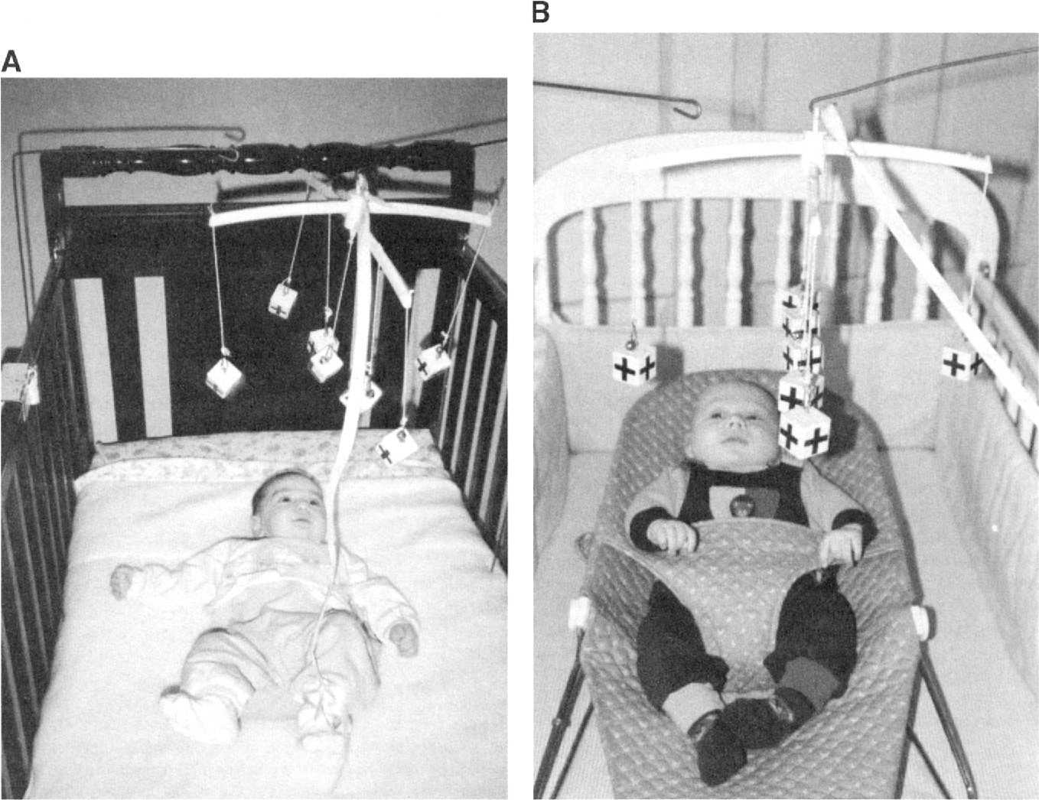
Rovee-Collier Experiments

Slide 23
Infant Memory (1)
Rovee-Collier’s experiments revealed three important features of infant memory:
  An event from the past is remembered
  Over time, the event can no longer be recalled
  A cue can trigger a memory that seems to have been forgotten

Slide 24
Infant Memory (2)
Memory improves rapidly in older infants and toddlers
  Require fewer exposures to new information to be able to remember it
  Begin to remember things for longer periods before forgetting

Slide 25
Long Term Memory (1 of 7)
Autobiographical memory – memory for events and life details
  Narrative like in structure
  Important, because it helps construct a personal life history and helps relate personal experiences to others
  Not based on general knowledge
    Different than knowing the capital of Texas

Slide 26
Long Term Memory (2 of 7)
The foundations for autobiographical memory emerges early in life
  Infants and toddlers have basic memory abilities that allow them to remember past events
  Unfortunately, they also experience rapid forgetting so many experiences never make it to long term memory

Slide 27
Long Term Memory (3 of 7)
Autobiographical memory in preschoolers:
  Memory systems are robust enough to support this type of memory
  Exists for significant events in one’s past
  Appears as a sense of self emerges
    Understanding that they exist independently in space and time
    Provides coherence and continuity to their experience

Slide 28
Long Term Memory (4 of 7)
Childhood (infantile) amnesia:
  We retain very few autobiographical memories of events that occurred during the first few years of life.

Slide 29
Long Term Memory (5 of 7)
Reasons for early memory loss:
  Immature hippocampus and related memory structures
  Lack of language
  Level of sociocultural support
  Sense of self
  Verbatim versus gist storage

Slide 30
Long Term Memory (6 of 7)
Young children recall more details about unique events
Elaborative conversation style:
  parents discuss new aspects of an experience, provide more information, and affirm responses
Notes:
Learning Objective: 7-3: Summarize changes in attention, memory, and thinking during childhood.
C. Long-Term Memory
a. Episodic memory: memory for events and information acquired during these events
c. Autobiographical Memory
i. Autobiographical Memory: a type of episodic memory that refers to recall of personally meaningful events that took place at a specific time and place in one’s past
ii. Young Children
1. Young children recall more details about events that are unique or new, such as a trip to the circus, which 3-year-old children will recall for a year or longer
2. The way adults talk with the child about a shared experience can influence how well the child will remember it
3. Elaborative conversation style—parents discuss new aspects of an experience, provide more information to guide a child through a mutually rewarding conversation, and affirm the child’s responses
iii. Older Children
1. Children become better able to organize their reports by time and include more information about place, and they eventually include causal connections that help explain the course of events
2. Autobiographical memory becomes more durable

Slide 31
Long Term Memory (7 of 7)
Preschool-age children may be more vulnerable to suggestion, especially after repeated questioning
  Adults’ memory also influenced by suggestion!
During middle childhood, children learn more strategies and get better at using them more effectively
Notes:
Learning Objective: 7-3: Summarize changes in attention, memory, and thinking during childhood.
v. Knowledge and Memory Strategies
1. Easier to recall new information about already-familiar topics, and existing knowledge makes it easier to learn more about that topic
2. During middle childhood, children learn more strategies and
get better at selecting them, modifying them, and using them more effectively, which contributes to advances in performance
vi. Culture and Memory Strategies
1. Strategies for cognitive tasks (and the tasks themselves) vary with culture
2. All children amass a great deal of information and as they get older, organize it in more sophisticated ways, and encode/retrieve it more efficiently
c. Memory Suggestibility
i. Preschool-age children may be more vulnerable to suggestion,
especially after repeated questioning
ii. Some children are better able to resist suggestive questioning
iii. Adults’ memories are also influenced by suggestion

Slide 32
Why does Memory Improve with Age? (1 of 2)
Changes in Capacity?
  Encoding of information improves over the first several years of life.
  Consolidation and storage of memories show improvement over infancy.
Changes in memory strategies?
  3 & 4-year-olds: Rote repetition
  Older children: Organizational strategies
  Adolescents/Adults: Deep Elaboration

Slide 33
Why does Memory Improve with Age? (2 of 2)
Increased Knowledge about memory?
  Metamemory:
    Knowledge of memory and the process of memory
    Influenced by children’s language skills
  Metacognition:
    Knowledge of the human mind and of the range of cognitive processes
    Present in 3- and 4-year-olds

Slide 34
Theory of Mind (1 of 3)
Theory of Mind: children’s awareness of their own and other people’s mental processes
Theory of Mind emerges alongside identity formation!

Slide 35
Theory of Mind (2 of 3)
Assessed by examining children’s abilities to understand people can hold different beliefs about an object/ event
False Belief Task: 3-year-olds show a pattern of false belief errors that are robust across procedures and cultures
Notes:
Learning Objective: 7-3: Summarize changes in attention, memory, and thinking during childhood.
c. Theory of Mind
i. A child who believes he is having hot oatmeal for breakfast will be surprised upon receiving cold spaghetti
ii. Assessed by examining children’s abilities to understand people can hold different beliefs about an object/ event
iii. False Belief Task
1. Young children do not understand people can hold different beliefs and some may be incorrect
2. Three-year-olds show a pattern of false belief errors that are robust across procedures and cultures.
iv. Cognitive Skills and False-Belief Understanding
1. Advanced cognition is needed for children to learn abstract concepts such as belief
2. Performance on false belief tasks is related to language development

Slide 36
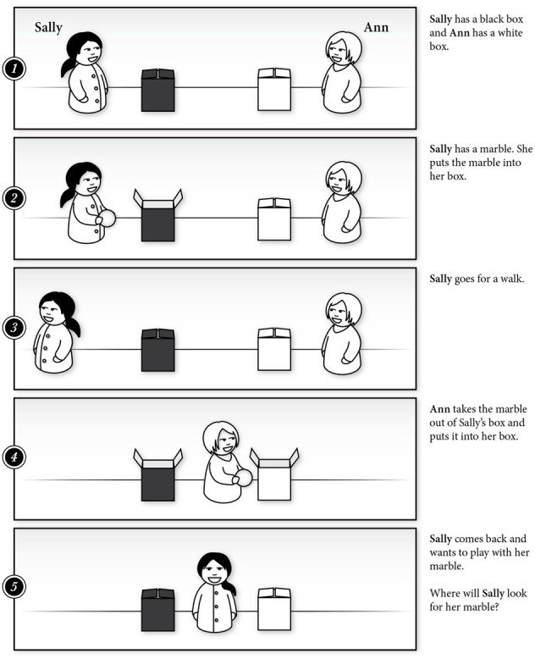
Notes:
Learning Objective: 7-3: Summarize changes in attention, memory, and thinking during childhood.
c. Theory of Mind
i. A child who believes he is having hot oatmeal for breakfast will be surprised upon receiving cold spaghetti
ii. Assessed by examining children’s abilities to understand people can hold different beliefs about an object/ event
iii. False Belief Task
1. Young children do not understand people can hold different beliefs and some may be incorrect
2. Three-year-olds show a pattern of false belief errors that are robust across procedures and cultures.
iv. Cognitive Skills and False-Belief Understanding
1. Advanced cognition is needed for children to learn abstract concepts such as belief
2. Performance on false belief tasks is related to language development

Slide 37
Theory of Mind (3 of 3)
Older children generally know more, and their larger knowledge base may provide some boost to their ability to learn and remember.
Older children have formed more elaborate scripts for what typically happens in many situations and use these scripts to aid their recall.
Notes:
More able to think back to their own experiences

Slide 38
Memory changes in Adolescence (1 of 3)
New learning and memory strategies emerge
  Elaboration is mastered
  Deliberate use of learning strategies

Slide 39
Memory changes in Adolescence (2 of 3)
Adolescents perform cognitive operations faster than children do.
Have greater functional use of their working memory.
No differences on tasks of low complexity
  Face recognition

Slide 40
Memory Changes in Adolescence (3 of 3)
Knowledge base continues to expand during adolescence.
Metamemory and metacognition improve.
Differences?
  Adolescent girls consistently report using more metacognitive strategies than boys.
  Students from higher socioeconomic backgrounds report more use of metacognitive strategies.

Slide 41
Information Processing in Adolescence
Decision Making
  Under lab conditions, adolescents demonstrate rational decision-making
  When faced with unfamiliar, emotionally charged situations, adolescents reason more poorly
Notes:
Learning Objective: 7-4: Analyze changes in information processing and decision making during adolescence. Summarize changes in attention, memory, and thinking during childhood.
E. Decision Making
a. Under laboratory conditions, adolescents demonstrate rational decision-making comparable to adults; however, laboratory studies usually present dilemmas very different from everyday decisions
b. When faced with unfamiliar, emotionally charged situations, spur-of-the moment decisions, pressures to conform, poor self-control, and risk and benefit estimates that favor good short-term and bad long-term outcomes, adolescents tend to reason more poorly than adults
c. Adolescents’ heightened tendency for risk taking can be detrimental, but some engage in positive risk taking (socially acceptable, potential for (un)desirable outcomes, uncertain)
d. Adolescents learn decision-making through experience

Slide 42
Memory and Aging
Most elderly adults report at least minor difficulties remembering things.
Not a strong relationship between memory concerns and memory performance.
Forgetfulness can be normal.
Reminiscence bump: older adult’s higher likelihood to recall experiences early in life, between ages 10 and 30

Slide 43
Areas of Strength and Weakness
Cross-sectional research
Declines become noticeable in the 70s.
Difficulties in memory are more severe among the oldest elderly.
Not everyone experiences difficulties.
Not all kinds of tasks cause difficulty.
Older adults:
  Are slower to learn and retrieve information.
  Far worse when the material to be learned is unfamiliar
  Are deficient on tasks requiring recall memory than on tasks requiring only recognition.
  Have more trouble with explicit memory tasks.

Slide 44
Why does Memory Decline? (1 of 4)
Attention
  Selective attention becomes more challenging with age
  Older adults make more errors of commission and omission when there are distractors and are slower at responding and inhibiting a response
  Training in how to divide attention between two tasks improves performance
Notes:
Learning Objective: 7-5: Examine changes in information processing over adulthood, including influences on cognitive change.
V. Information Processing in Adulthood
A. Attention
a. Selective Attention
i. Becomes more challenging with age
ii. The cocktail party effect—ability to follow one conversation and switch to another, such as at a party
b. Inhibitory Control
i. Becomes more difficult with age
ii. Older adults make more errors of commission and omission when there are distractors and are slower at responding and inhibiting a response
iii. Training in how to divide attention between two tasks by using selective attention improves the performance of older adult
c. Experience and Attention
i. Experience, practice, and motivation affect adults’ information processing capacities
ii. Conflicting results in studying adults’ inhibition show age-related changes are complex

Slide 45
Why does Memory Decline? (2 of 4)
Processing Speed
  Greatest age-related shift in information processing capacity is a reduction in the speed of processing
  Distractable adults show slowed responses on standard tasks, but performance improves when tasks reduce distractions
Notes:
Learning Objective: 7-5: Examine changes in information processing over adulthood, including influences on cognitive change.
D. Processing Speed
a. Greatest age-related shifts in information processing capacity is a reduction in the speed of processing
b. Attention and Processing Speed
i. Highly distractable adults show slowed responses on standard tasks measuring processing speed, but performance improves when tasks reduce distractions
ii. Task-relevant factors also influence performance

Slide 46
Why does Memory Decline (3 of 4)
Knowledge base:
  Semantic memory for vocabulary increases until age 65.
  Have more knowledge in real-world categories.
  Deficiencies in knowledge base are not the source of memory problems.
Metamemory:
  Misjudge the accuracy of their memory.
  Isolated areas of weakness

Slide 47
Why does Memory Decline? (4 of 4)
Education is a strong predictor of cognitive performance and problem-solving tasks in old age
Certain physical and mental health conditions associated with cognitive declines
Interventions training older adults on cognitive skills can preserve and even reverse some age-related declines (Seattle Longitudinal Study)
Notes:
H. Influences on Cognitive Change in Adults
a. Education
i. Measured by years of formal schooling or literacy levels on reading tests
ii. Strong and consistent predictor of cognitive performance and problem-solving tasks in old age
iii. Effects are debated, but generally recognized that cognitive engagement predicts the maintenance of mental abilities
b. Health
i. Certain physical and mental health conditions associated with cognitive declines
ii. Difficult to discern directional effects of health and cognitive decline
iii. Sensory impairments associated with age-related declines in cognition
c. Cognitive Interventions
i. Interventions training older adults and encouraging the use of cognitive skills can preserve and even reverse some age-related cognitive declines (Seattle Longitudinal Study)
ii. Certain research suggests older adults’ improvement with intervention is similar to that of younger adults, and working memory gains generalize to other measures of fluid intelligence
iii. Variability in lasting effects of intervention
iv. Variability in everyday functioning

Slide 48
Developing Expertise
Experts:
  Know more than novices do
  Have a more organized knowledge base
  Are able to use their knowledge and the specialized strategies
  Do not need to think much

